Slide 1


HOSTEL MANAGEMENT
SYSTEM
PRESENTED BY
AKHIL AS 22PMC103

Slide 2
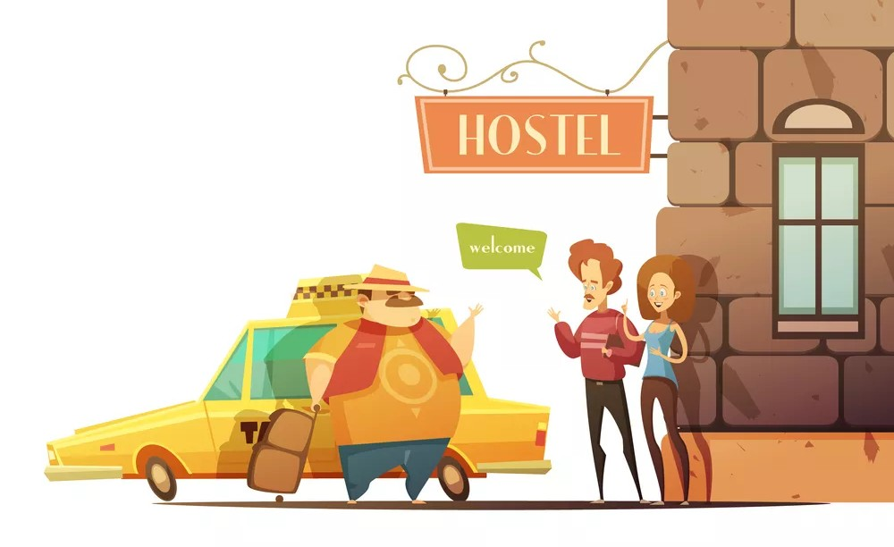
HOSTEL MANAGEMENT SYSTEM
FOR COLLEGE
2
Table of Contents
3
INTRODUCTION
4
ABSTRACT
5
PROJECT REQUIREMENTS
6
FEATURES AND HIGHLIGHTS
7
TECHNICAL ASPECTS
8
ARCHITECTURE
9
DATABASE (CLASS DIAGRAM)
13
CONCLUSION
10
CHALLENGE
11
SCREENSHOT
12
14
REFERENCES
FUTURE ENHANCEMENTS

Slide 3


Hostel Management System
FOR COLLEGE
4
ABSTRACT
Hostel Management is a web application that is created for booking hostels for individuals..
This will limit manual work and also make hostel allocation so much easier for students and hostel administrators.It manages data in the database and retrieves it whenever required.
We design this system at the request of the hostel management, through this they cannot require people to handle and calculate things. The developed system overcomesthe drawbacks of manual hostel management it's said to be more user-friendly.
The modules are Registration, Room Allocation, Report. This software Online HotelManagement is developed using Python, Sqlite.Here, Python and Sqlite as back-end and HTML and CSS as front end. The softwaretools here is Microsoft SQL Server, here any web browser can be used. The development tool used here is pycharm.

Slide 4
Hostel Management System
FOR COLLEGE
5
FUNCTIONAL REQUIREMENTS
·Registration &Login
User can book hostel room
Admin can manage hostels rooms
User can change password
Admin can manage students
User can edit profile
Admin can manage courses
Report Modules

Slide 5
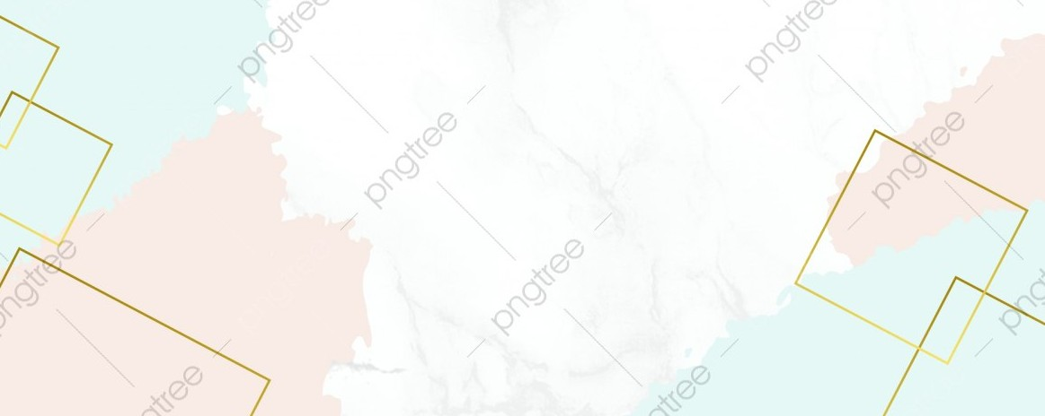
Hostel Management System
FOR COLLEGE
FEATURES AND HIGHLIGHTS
Registration & Login:
Users should be able to create an account by providing necessary details.
5
Admin can manage students: Admin should have the ability to add new students to the system.
Admin should be able to view, update, and delete student information.
Admin can manage hostel rooms: Admin should be able to add new hostel rooms to the system.
Admin should be able to view, update, and delete existing hostel rooms.
Admin can manage courses: Admin should be able to add new courses offered by the hostel.
Admin should have the ability to view, update, and delete course information.

Slide 6

Hostel Management System
FOR COLLEGE
5
Report Modules:
The system should generate reports for admin and users regarding various aspects such as Fees, room allocations, and personal details.
User can change password:
Users should have the option to change their account password.
The system should provide a secure mechanism for users to update their passwords.
User can edit profile:
Users should have the ability to edit their personal details such as contact information or emergency contacts.
Student can book hostel rooms Students should have the ability to specify their preferences while searching for Available hostel rooms.

Slide 7
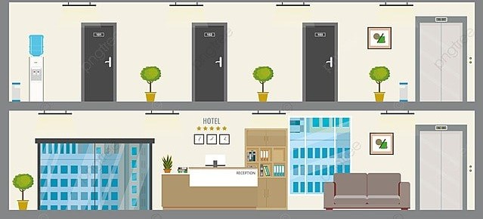

Hostel Management System
FOR COLLEGE
TECHNICAL ASPECTS
6
Programming Language
Web Framework
Python Django(Backend)
Frontend Framework
Html, Css, JavaScript
Database(SqLite3)
3rd party libraries
Bootstrap
Jazzmin(Django Admin)

Slide 8
Social Media Marketing Strategies
FOR SMALL BUSINESS
8
ARCHITECTURE
Presentation Layer (Frontend): HTML/CSS: Responsible for the user interface and styling.
JavaScript: Handles interactivity and client-side validation
Database Layer:
Database Management System (DBMS): Stores and manages the system's data.
Relational Database (SQLite): Handles structured data related to users, bookings, buses, etc.
Application Layer (Backend):
Web Server: Receives HTTP requests and routes them to the appropriate components.
Authentication and Authorization: Manages user authentication and authorization for secure access to the system.
Business Logic: Implements the core functionalities of the flight booking system.
API: Defines endpoints to expose functionalities for frontend and external integrations.
TEAM 2

Slide 9
Hostel Management System
FOR COLLEGE
9
DATABASE(CLASS DIAGRAM)
TEAM 2

Slide 10

Social Media Marketing Strategies
FOR SMALL BUSINESS
8
CHALLENGES DURING THE DEVELOPMENT
User Authentication and Security: Implementing a robust user authentication system with appropriate security measures can be a challenging task.
Validation Mechanisms: Implementing validation mechanisms helps ensure that user input is accurate and consistent.
Designing User Interface: Creating an intuitive and user-friendly interface is crucial for a successful bus booking system.
Database Design and Management: Designing an efficient database schema and managing the database operations can be complex.
Testing and Bug Fixing: Thorough testing is essential to identify and fix any bugs or issues in the system.

Slide 11
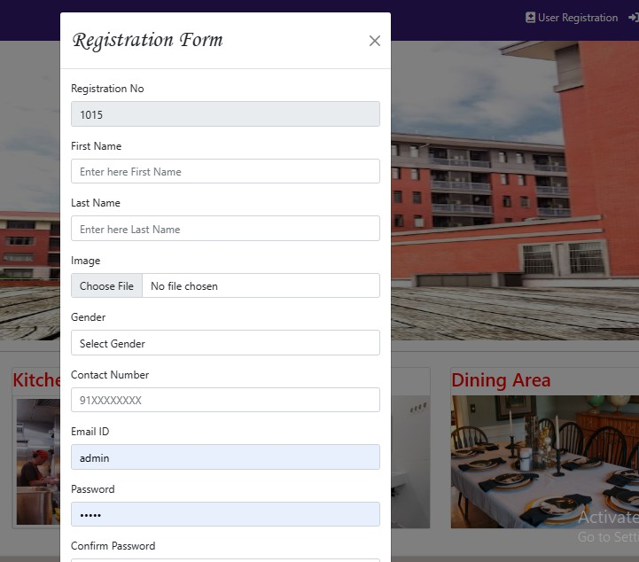
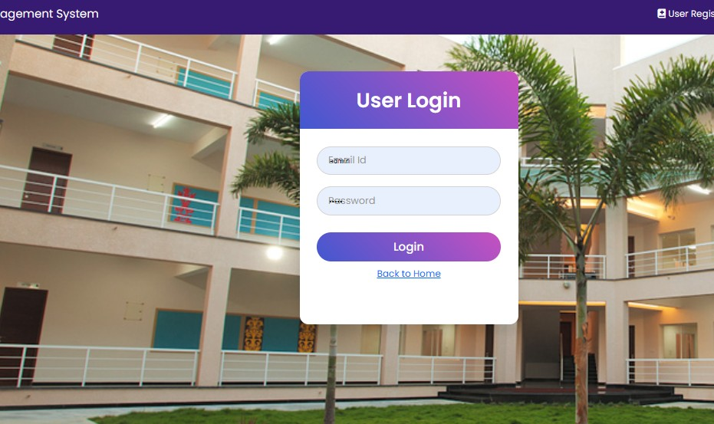
Hostel Management System
for college
IMPORTANTS SCREENSHOTS
LOGIN PAGES
8
REGISTRATION PAGE
TEAM 2

Slide 12
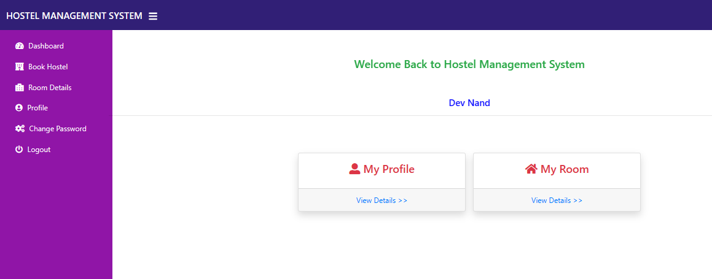
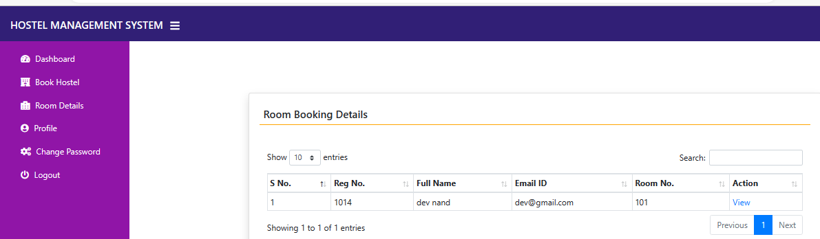
Hostel Management System
FOR COLLEGE
8
USER HOME
VIEW BOOKING DETAILS
TEAM 2

Slide 13
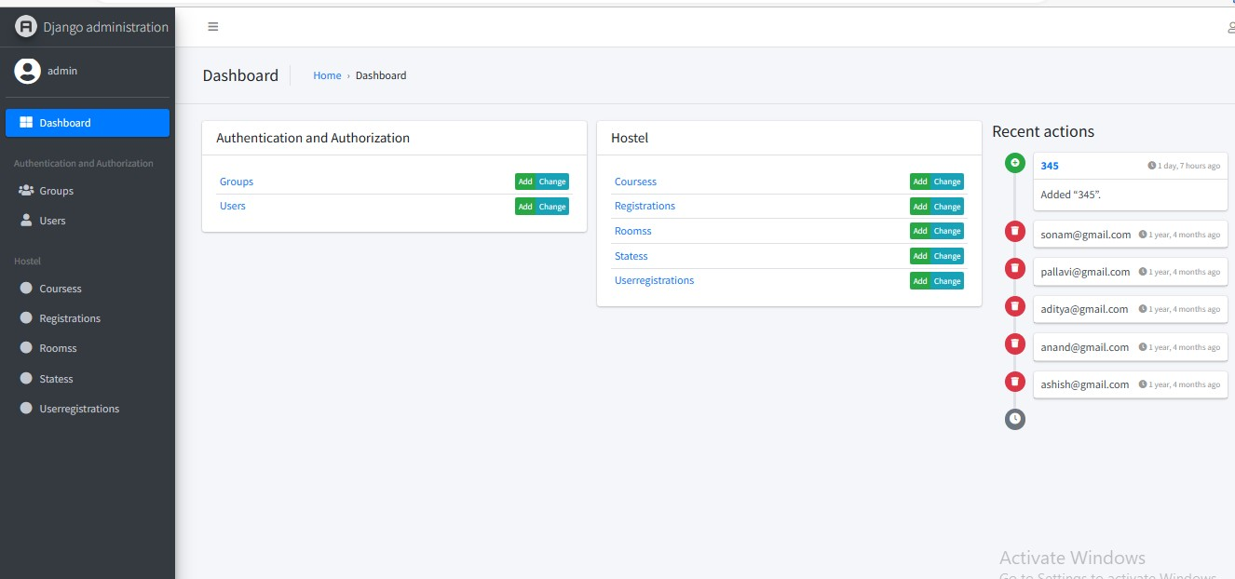
Hostel Management System
FOR COLLEGE
8
ADMIN HOME
TEAM 2

Slide 14

Hostel Management System
FOR COLLEHE
9
FEATURE ENHANCEMENT
Room Allocation Algorithm:
Improve the room allocation algorithm to automatically assign rooms to students
Payment and Billing System:
Integrate a payment and billing system to automate the process of collecting hostel fees from students.
Notifications and Reminders:
Implement a notification system to send automated reminders to students for fee payment, upcoming events, maintenance schedules, etc.
TEAM 2

Slide 15

Hostel Management System
FOR COLLEGE
Conclusion
9
In conclusion, the Hostel Management System is a comprehensive solution designed to simplify and automate the management of hostels, students, courses, and related administrative tasks. It offers a range of features and functionalities to ensure smooth operations and enhance the user experience for both administrators and users.
REFERENCES
.https://youtu.be/YZvRrldjf1Y
.https://youtu.be/tUqUdu0Sjyc
.https://youtube.com/playlist?list=PL-5.1WBLyFTg2vW-
_6XBoUpE7vpmoR3ztO
.https://docs.djangoproject.com/en/4.1/intro/tutorial01/
TEAM 2

Slide 16

The End of Presentation
THANK YOU FOR LISTENING
PRESENTER
AKHIL AS 22PMC103
COURSE
MINI PROJECT
DATE
2023 MAY 25TH

